Slide 1
Expense Manager
Preapared By: Guided BY:
Harsh Limbadiya (18TE403701) Miss. Viral Parekh
Hiren Shekhda (18TE403703) H.O.D of [CE/IT DEPARTMENT]
7th C.E.
C.U. Shah college of
Engineering and technology

Slide 2
OUTLINE :
Introduction
Objective and Goals of the System
Users of System
Background Study
Functional Requirement
Non-Functional Requirements
Hardware & Software Specification
Data Dictionary
UID (User Interface Design)
GUI (Graphical User Interface)

Slide 3
Introduction:
We are developing an android application named as “Expense Manager” and this application is used to manage the application user‘s daily expenses in a more efficient and manageable way.
By using this application we can reduce the manual calculations for their daily expenses and keep the track of the expenditure. In this application, user can provide his income to calculate his total expenses per day and these results will stored for unique user.

Slide 4
Goal:
Main goal of this system is to provide services to the user to manage his/her daily
expenditure.
Objective:
We are provide application to the user where user can keep his daily expense or income instead of keeping diary and also generate and save the report.

Slide 5
Types of User:
User:
In this application user can add income or expense and also modify that.
User can set the reminder and also generate and save the report of the expense or income.

Slide 6
Background Study:
KhataBook application
Tutorials point
Stack overflow

Slide 7
Functional Requirements:
Login
Register
Forgot password
Manage income
Manage expense
Generate report
Note
Logout

Slide 8
Non-Functional Requirements:
Efficiency :
It is the parameter to measure the performance of the software application.
Response Time :
The time taken to perform an action triggered by the user.
Availability :
This application is available for all people for any time to manage income or expense and set the reminder.

Slide 9
Hardware Specification:
Personal computer / laptop.
HDD: - 250GB.
RAM: - 2GB.
Electricity with ups.
Processor: - Intel Core 2 Duo.
Software Specification:
Operating System : Android version above 4.1
Software: Android studio 3.5 above
Front End Tools : JAVA, XML
Back End Tools : Firebase database
Office Automation Tools : Microsoft Visio or E-draw, Microsoft offices.

Slide 10
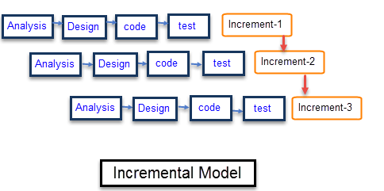
Development Strategy:
In incremental model, each phase is repeated until a fully functional system is not developed.
Every phase is completed in sequential way.
Every increment adds some more functionality to the system.

Slide 11
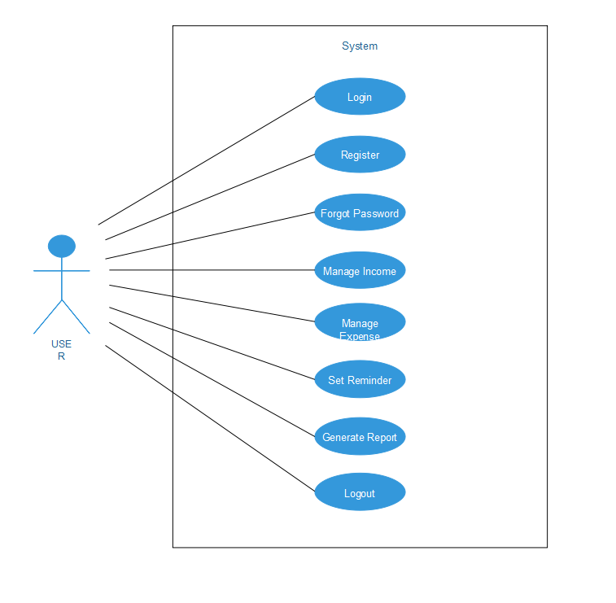
User Interface Diagram(UID):
USE CASE DIAGRAM FOR USER :

Slide 12
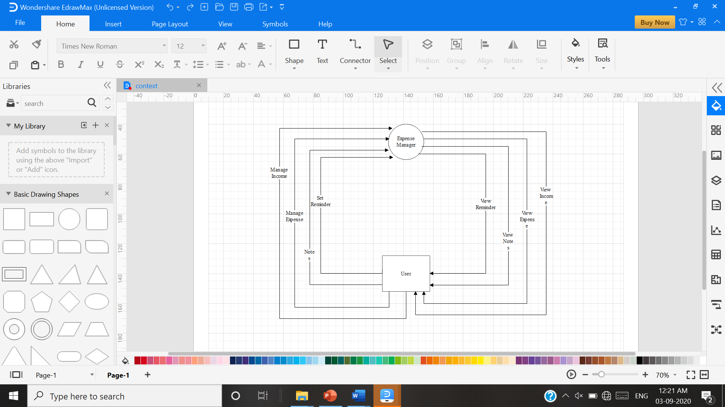
CONTEXT DIAGRAM:

Slide 13
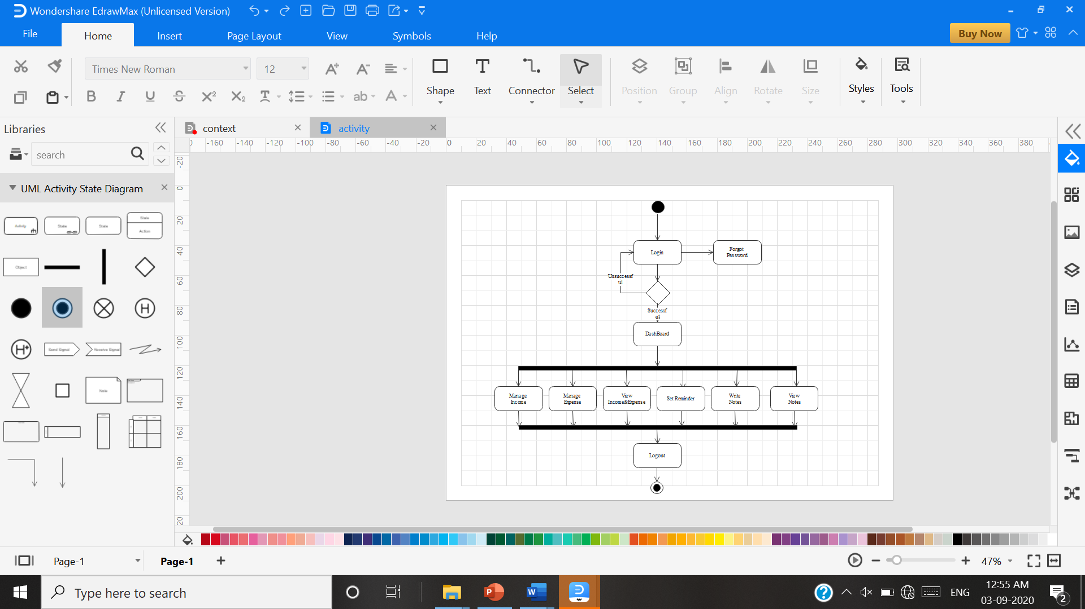
ACTIVITY DIAGRAM FOR USER :

Slide 14
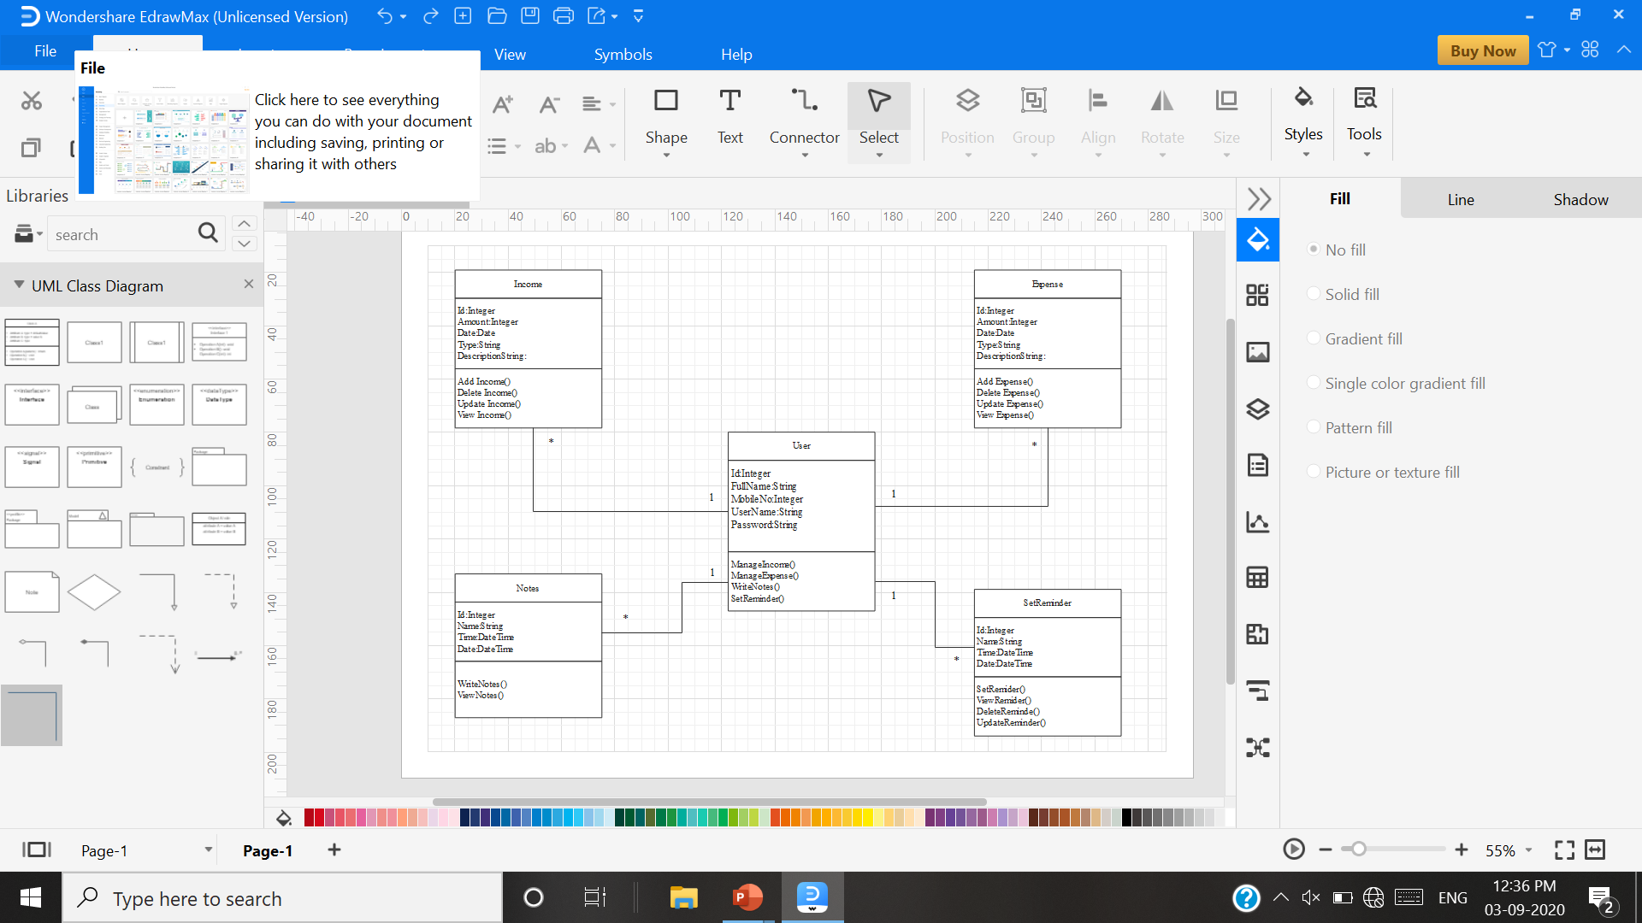
CLASS DIAGRAM :

Slide 15
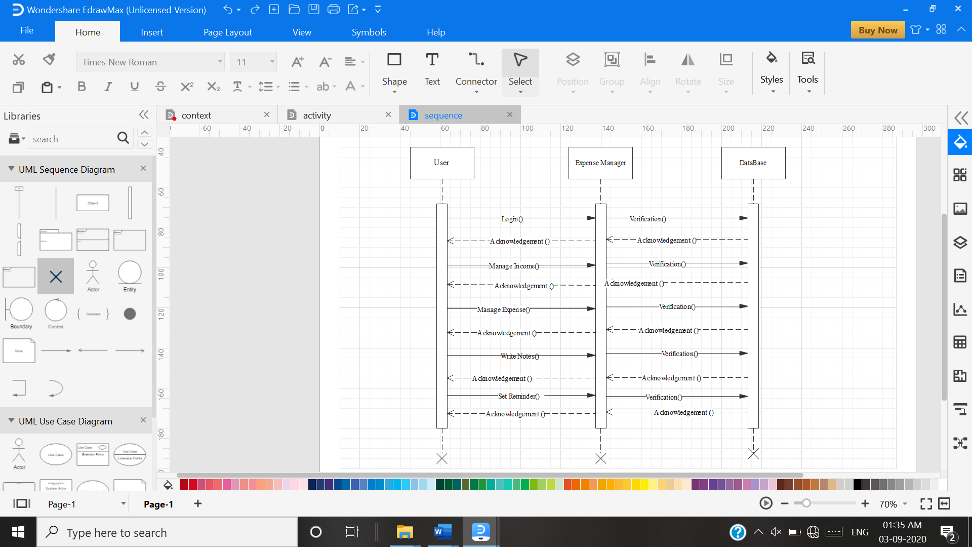
SEQUENCE DIAGRAM :

Slide 16
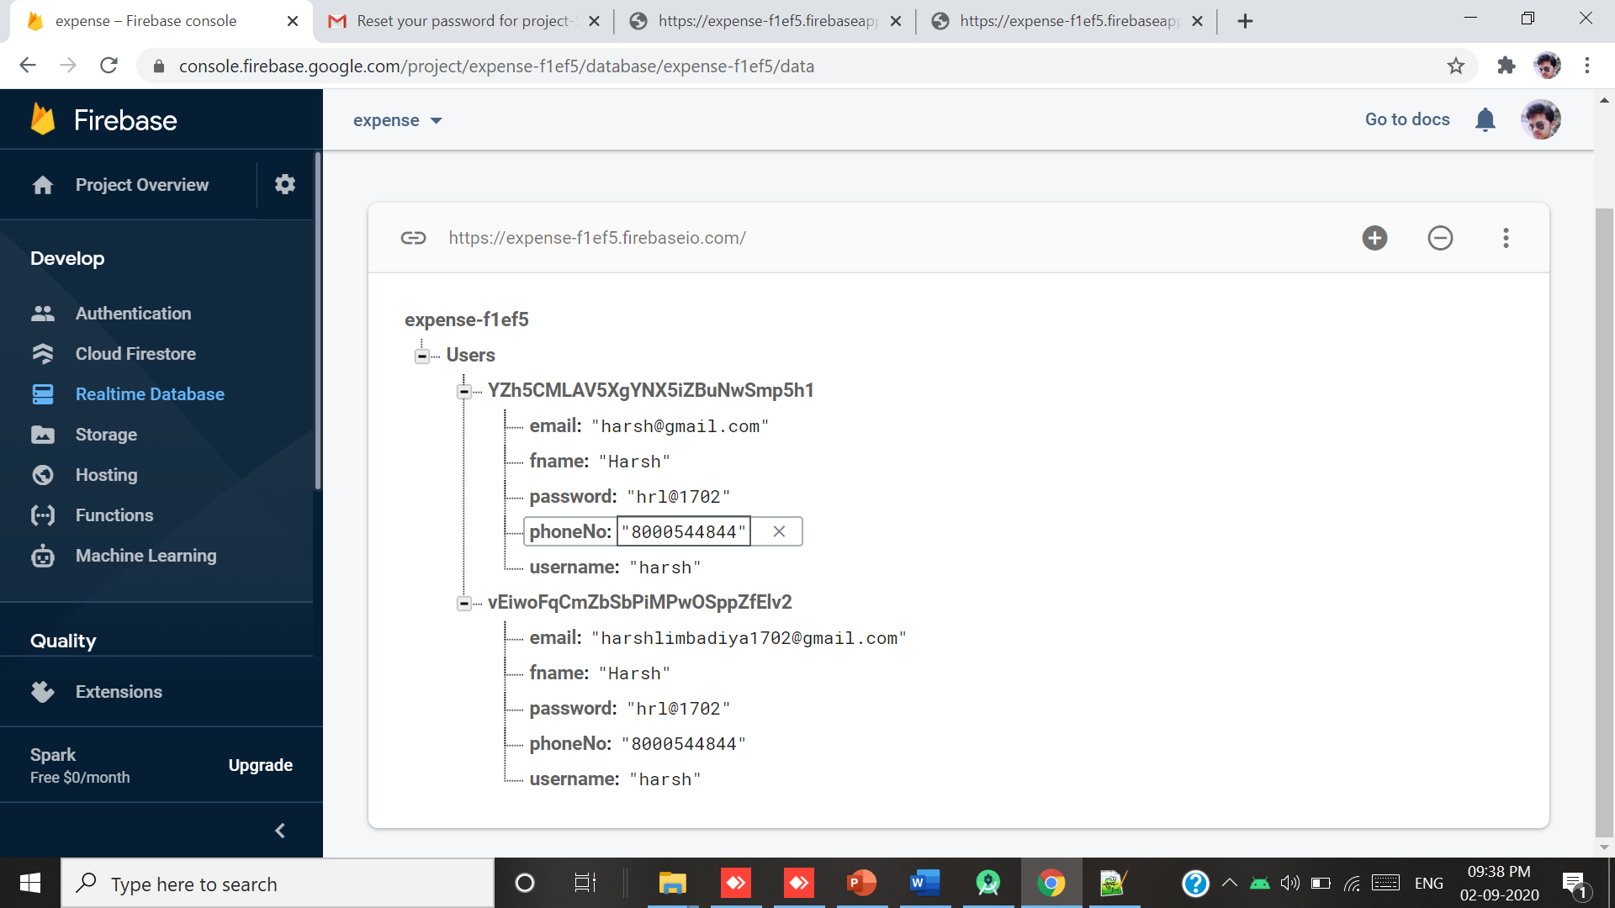
Data Dictionary
USER:

Slide 17
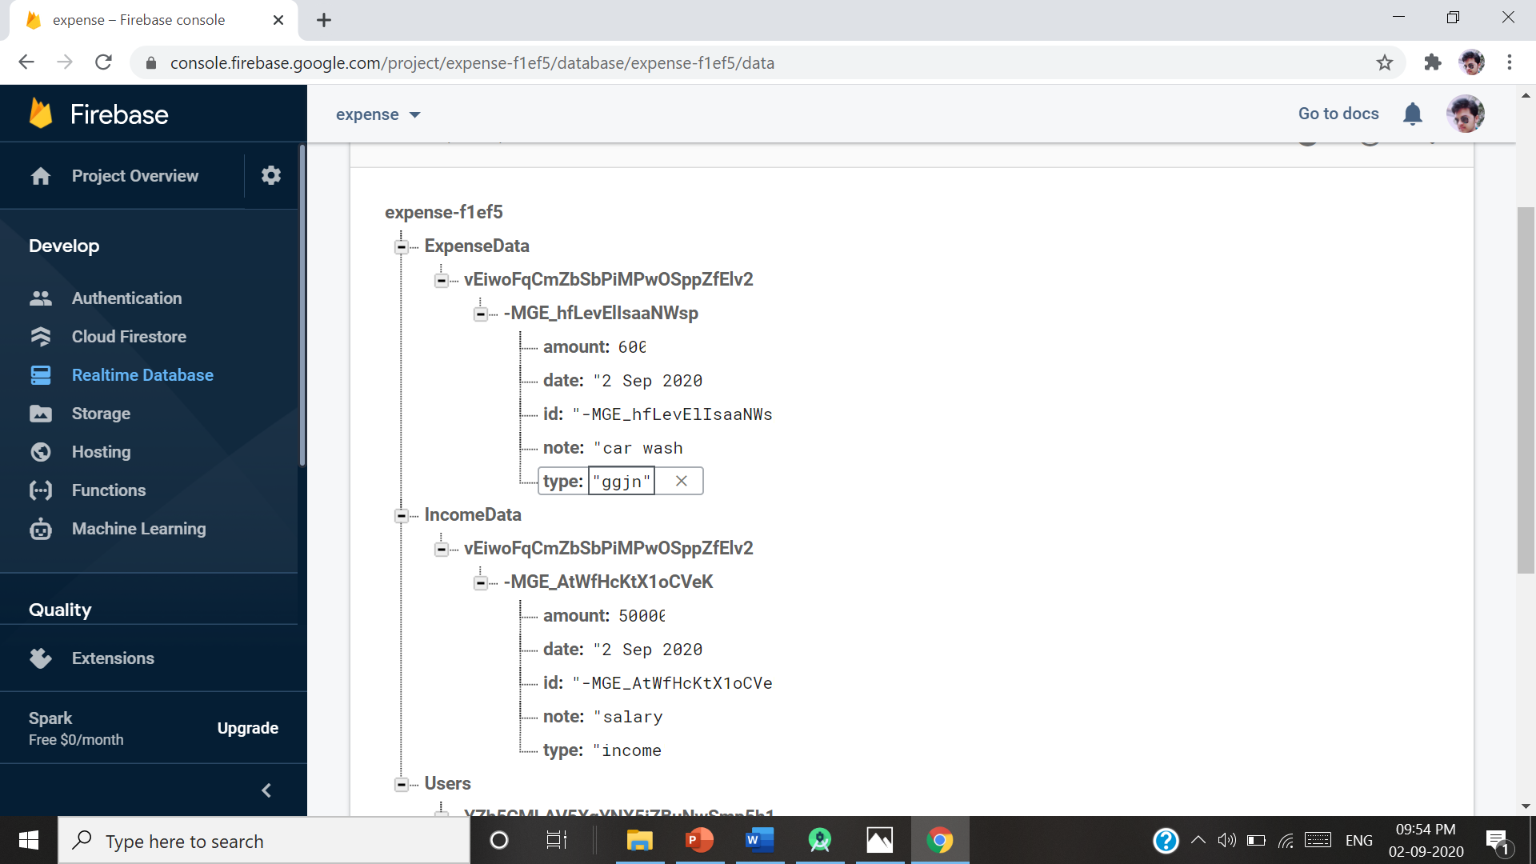
Expense And Income

Slide 18
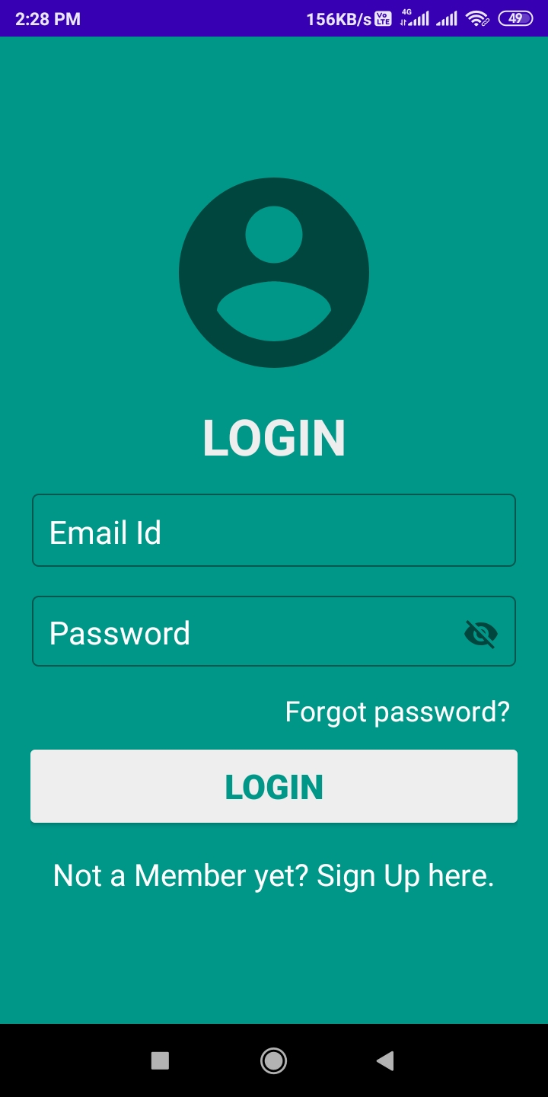
Graphical User Interface(GUI)
Login Page

Slide 19
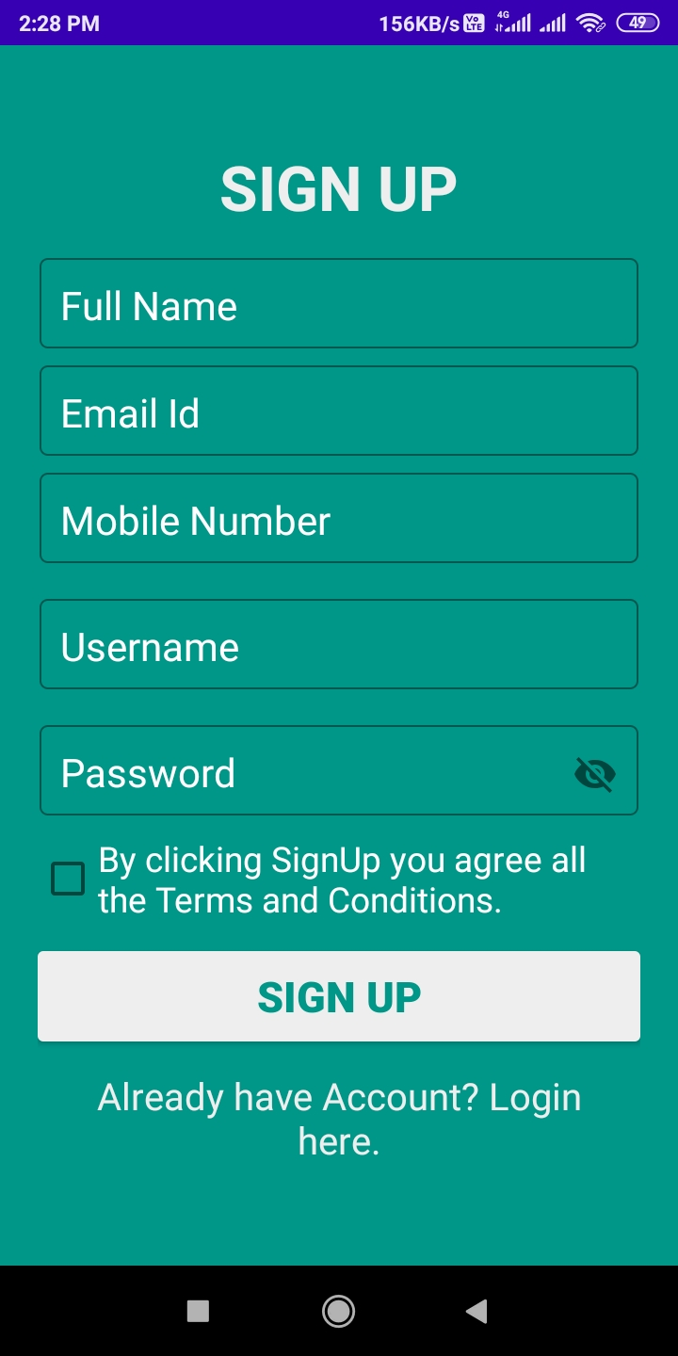
Register Page

Slide 20
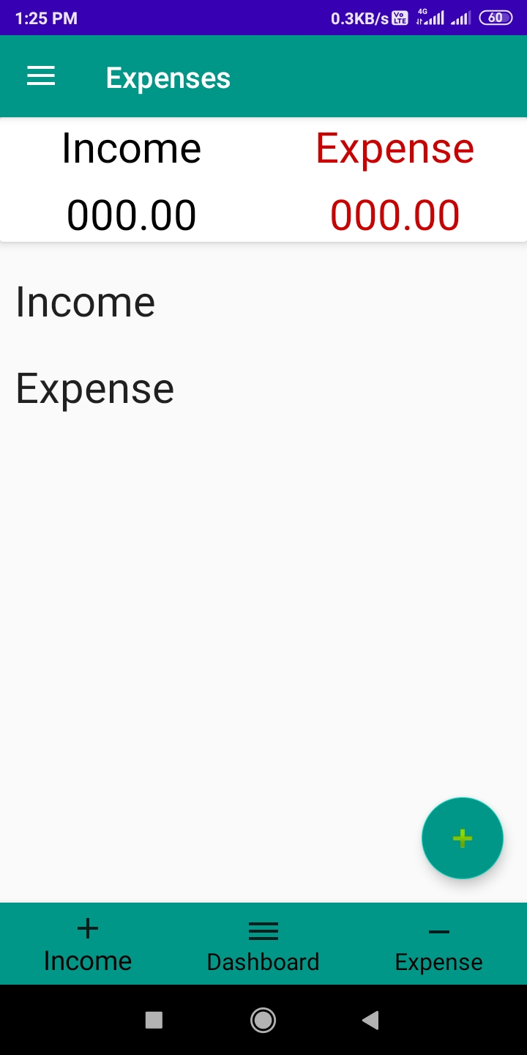
Dashborad

Slide 21
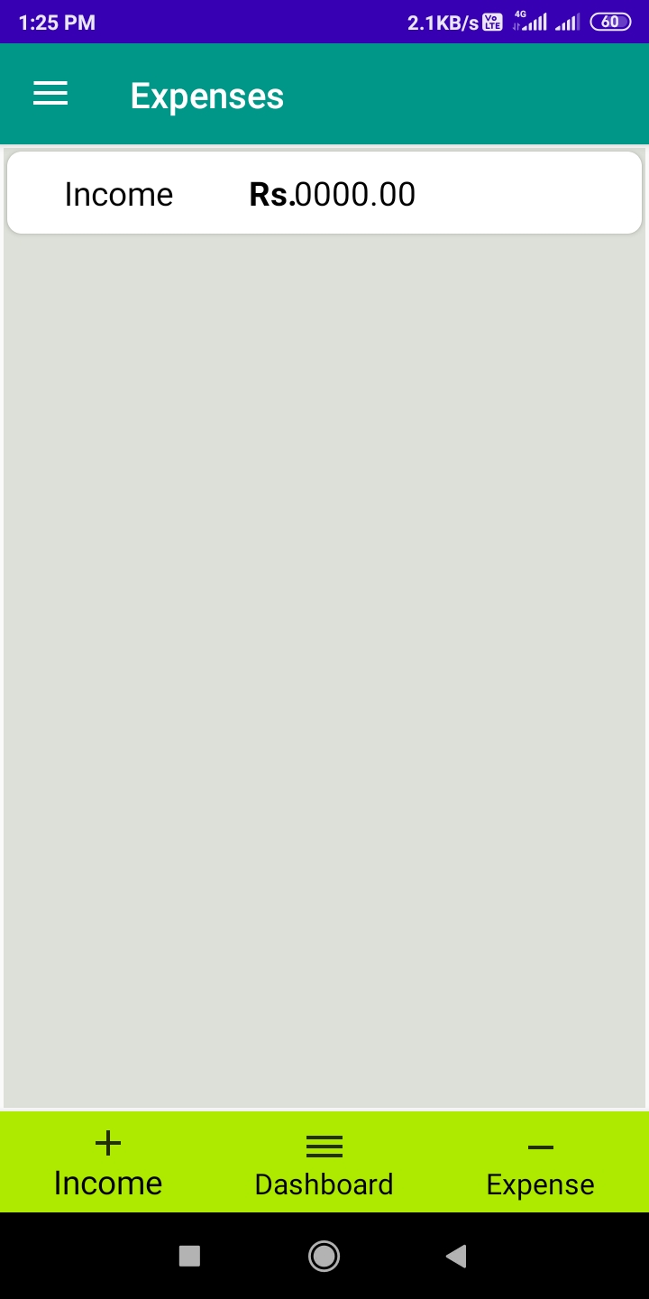
Income

Slide 22
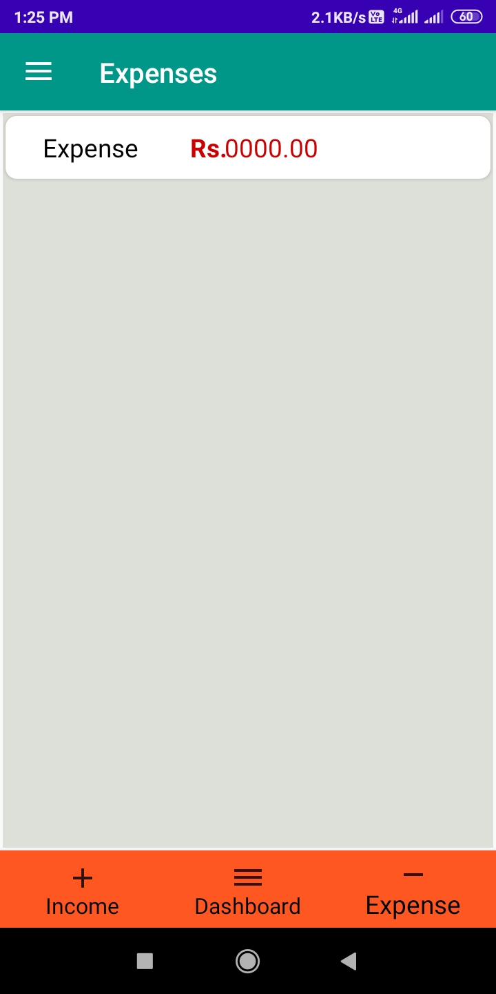
Expense

Slide 23
Thank you

